Slide 1

DATA 606 Capstone in Data Science
Wealth and Population Density Influences
on COVID-19 Cases and Vaccinations
Using Machine Learning
Phase III – Model Execution and Interpretations
Ken Noppinger
E-mail: knoppin1@umbc.edu

Slide 2
Model Execution (continued from Phase II)
Recap Phase II activities…
K-Means performed on California and Florida data for:
Population Per Square Mile and Cases Per Square Mile
Income and Vaccination Percentages
Clustered results showed:
Strong linear relationship of population and case density
Centroids indicated vaccination percentage increases with wealth.
What next…
Original stretch goal was to create a supervised model using clusters from the California / Florida K-Means clustering
Concerned that counties in California and Florida aren’t necessarily representative of the counties in all US states

Slide 3
K-Means web application
Web application built to provide researcher with options to perform more dynamic clustering runs
https://knoppin1.pythonanywhere.com
Application built using Dash (event driven modeling/visualization)
Select features to cluster and scale x and y axis (linear vs. log)
Scatter plot selected features and allow state filtering in support of regional scenarios
Bubble chart filter to see third feature on scatter plot of filtered data for counties in selected states
Run K-Means, show elbow curve, and allow selection of optimum clusters (K)
Run K-Means for selected number of clusters and display cluster scatter plot as well as choropleth map of clustered counties for selected states

Slide 4
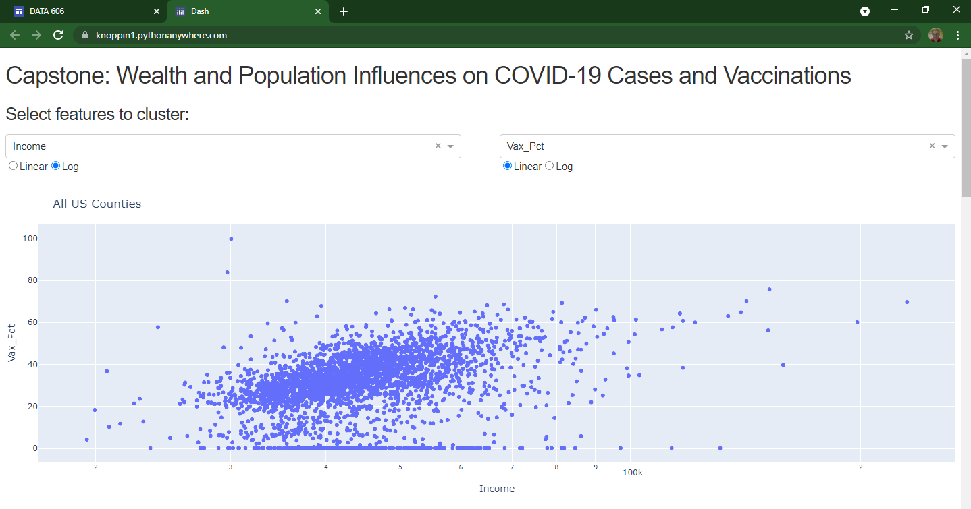
Example: K-Means web app Run
Compare Income and Vaccination Percentage Clusters for Mid-Atlantic and Northeast States

Slide 5
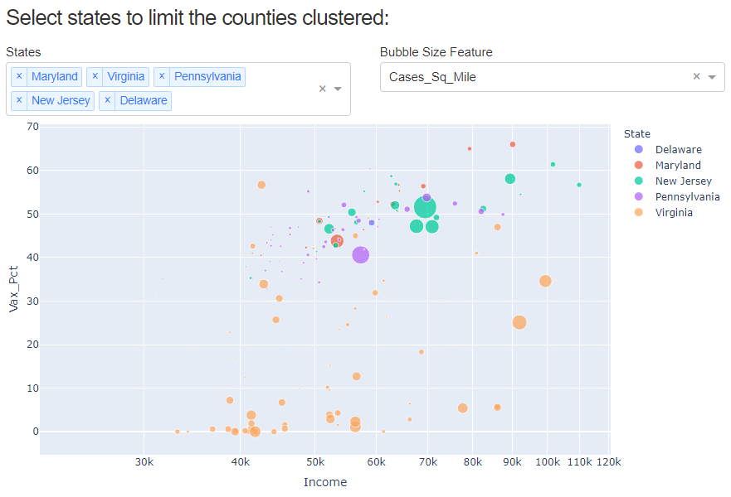
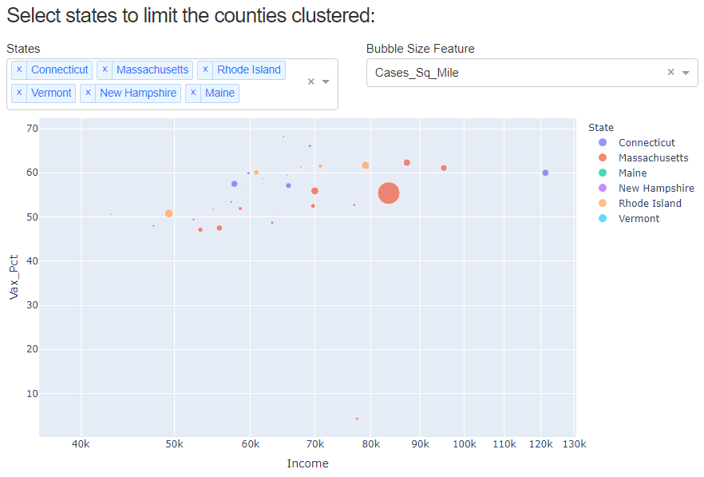
chart county data selected features
Mid-Atlantic Region States
Northeast Region States
Virginia counties show poor vaccination percentage regardless of median income and case density
Vaccinations are good overall and, with exception of one outlier county, percent increases with income level

Slide 6
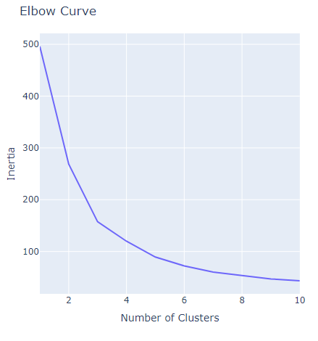
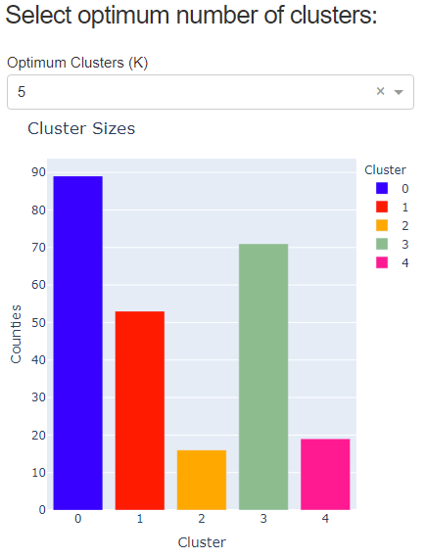
MID-ATLANTIC REGION States K-MEANS RUN
INERTIA CHART
OPTIMUM CLUSTERS
Optimum K could be 3, 4, or 5 clusters
Try each K value to see different cluster results

Slide 7
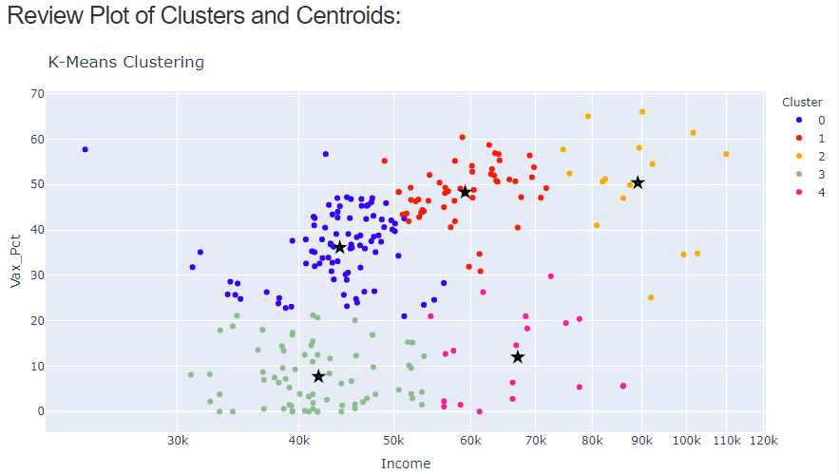
MID-ATLANTIC REGION States CLUSTER scatter plot

Slide 8
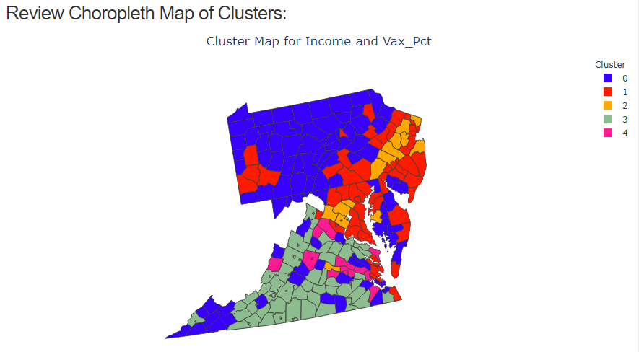
MID-ATLANTIC REGION States CLUSTER choropleth map

Slide 9
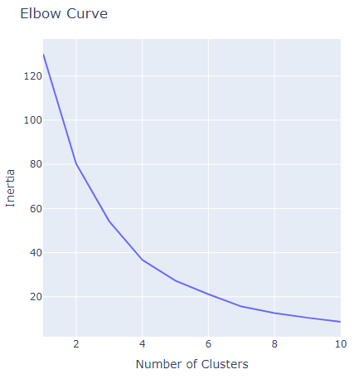
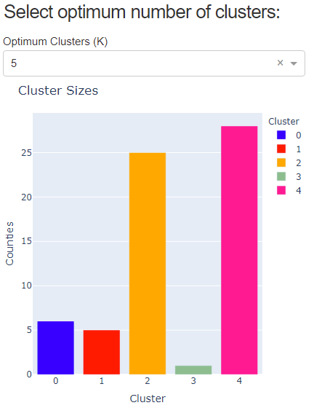
Northeast REGION States K-MEANS RUN
INERTIA CHART
OPTIMUM CLUSTERS
Optimum K could be 4, 5 or 6 clusters
5 clusters gives good result

Slide 10
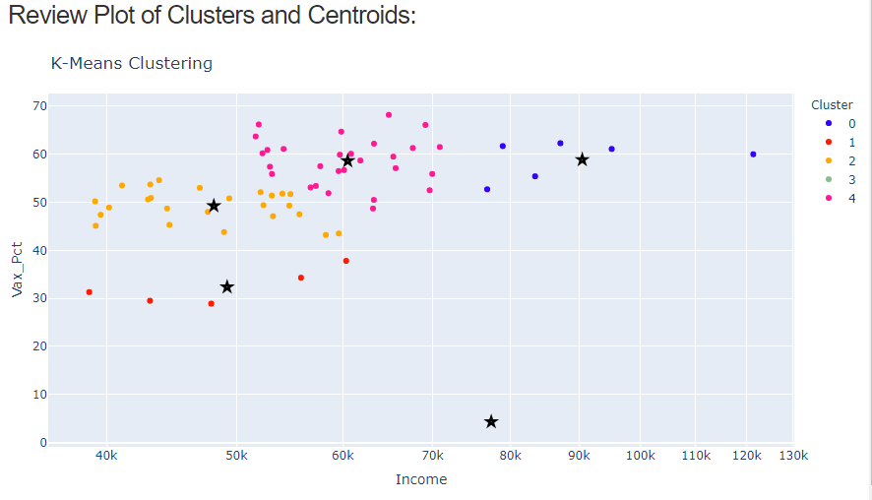
Northeast REGION States CLUSTER scatter plot

Slide 11
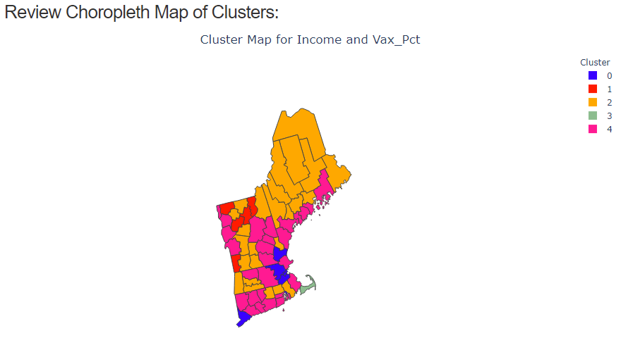
Northeast REGION States CLUSTER choropleth map

Slide 12
Interpretations and conclusions
Return to hypothesis questions:
Have wealthy counties been impacted differently by COVID-19?
County wealth does appear to impact the vaccination percentage of the population. Higher income generally drives higher vaccination.
The K-Means clustering runs show that both the scaling and the cluster meanings will vary in different regions of the country.
This variation was demonstrated with the K-Means web application in the example using Mid-Atlantic and Northeast regions above.
Both the correlation and the clustering did not reflect wealth having impact on COVID-19 case density.

Slide 13
Interpretations and conclusions
Return to hypothesis questions (continued):
Has county population density played a role in COVID-19?
The K-Means clustering reflected the strong linear correlation of population density and COVID-19 case density.
The clustering study showed cases per square mile increases with higher county population per square mile
Population density (actually used case density) did not appear as a major influencing factor in the bubble charting showing the affect of wealth on vaccination percentage. More clustering of the specific features might reveal another result in a different scenario of states, etc.

Slide 14
Interpretations and conclusions
Return to hypothesis questions (continued):
Have county wealth and population density together influenced COVID-19 infections and vaccinations?
This question was not answered directly through a K-Means clustering as part of this study and was left as a future exercise.
An enhancement could be made to the K-Means web application to allow selection of three features from the data set with three dimensional plotting.
Future clustered feature scenarios to investigate:
population density, median income, and case density
population density, median income, and vaccination percentage

Slide 15
Interpretations and conclusions
Takeaways
K-Means clustering proved useful to group counties having similar attributes regarding the features studied in the dataset (i.e., median income, population, cases, vaccinations, density, etc.).
It became apparent after crafting many Jupyter notebooks that the need for dynamic clustering and selection of these features to address specific questions would be valuable.
The development of the K-Means web application provided the flexible platform for completing the analysis and machine learning steps needed for this study.
This tool has value beyond the study and could be used to address "what if" scenarios benefiting public health workers as they react to changes in the COVID-19 cases and vaccinations throughout the pandemic.

